Slide 1

Industry Internship Project Presentation on Software Developer at Sarjen System
By
Mahendrasinh Dod(21162102002)
Under the guidance of
Prof. Neha Rajput
Institute of Computer Technology, Ganpat University
Date: 03/05/2024

Slide 2
Table of Contents
Introduction
Tools & Technology
Weekly Task
Conclusion
References

Slide 3
Introduction
Company Name: Sarjen System PVT LTD.
Internship Role: Software Developer
Mode: offline(Work From Office)
Internship period: 6 month

Slide 4
Tools & Technology
Tools:
Visual Studio 2022
Microsoft Sql Server
Technology:
Asp .Net Core Mvc
Sql server
Database

Slide 5
Week-1 To 4
Training and skill development
Orientation and Onboarding
Technical training (HTML/CSS, javascript, jquery)

Slide 6
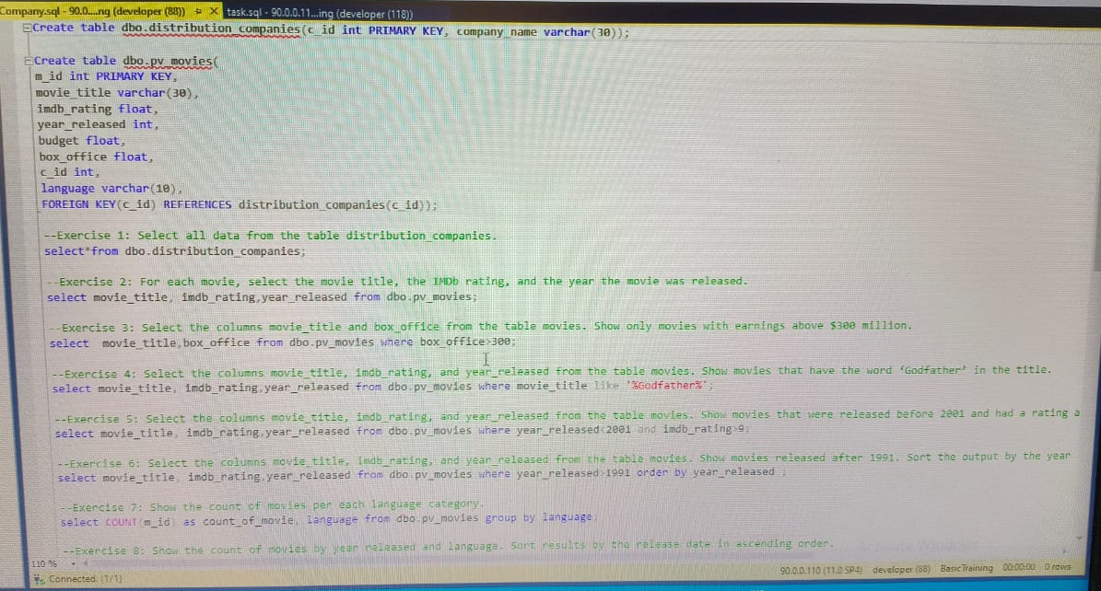
Technical training (Database)

Slide 7
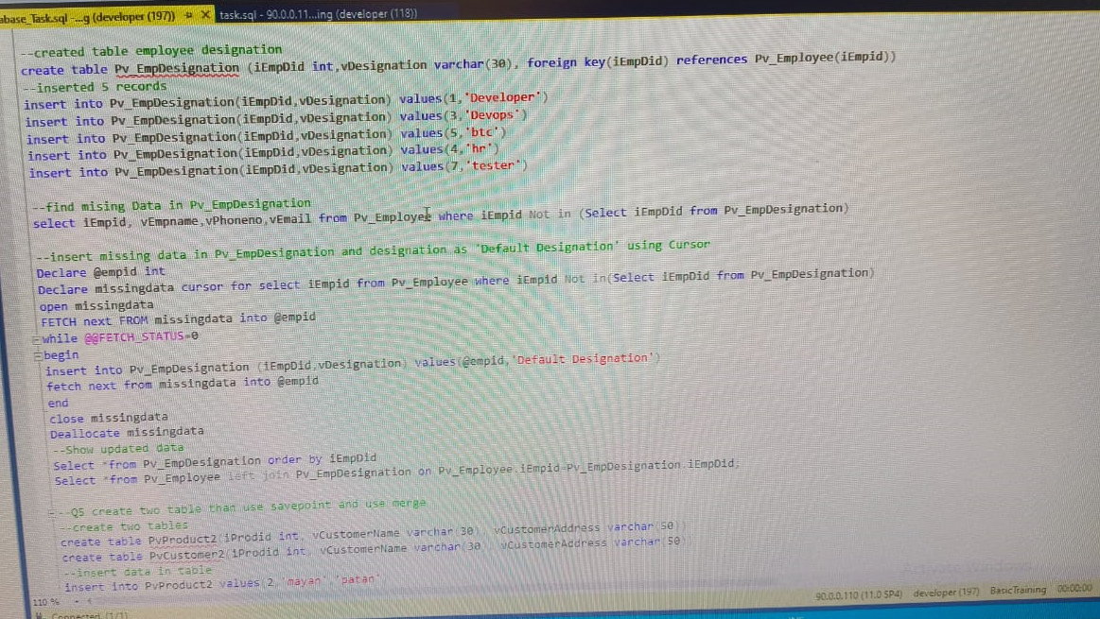
Simple Sql Query Task Assigned by Mentor

Slide 8
Week-5 To 8
Technical Training and Task
Task on crud operation in asp.net core mvc using ajax, javascript and jquery
Front End Training (HTML, CSS, JavaScript, React JS)
Learn how to use Asp.net core web api in mvc

Slide 9
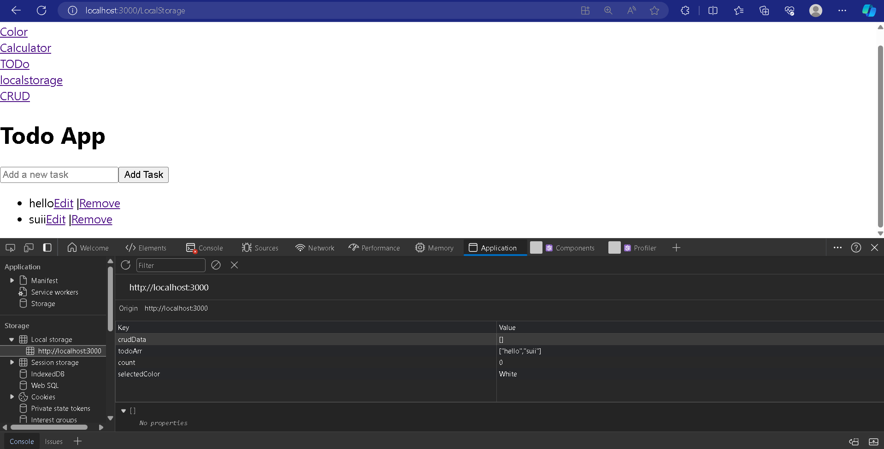
Task on example of local storage and session storage in react js

Slide 10
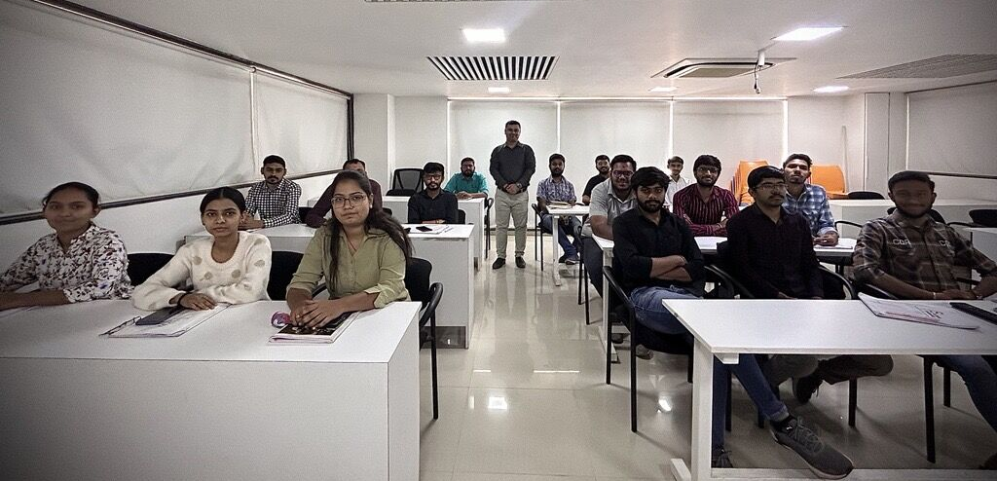
Front End Training(Javascript, React Js)

Slide 11
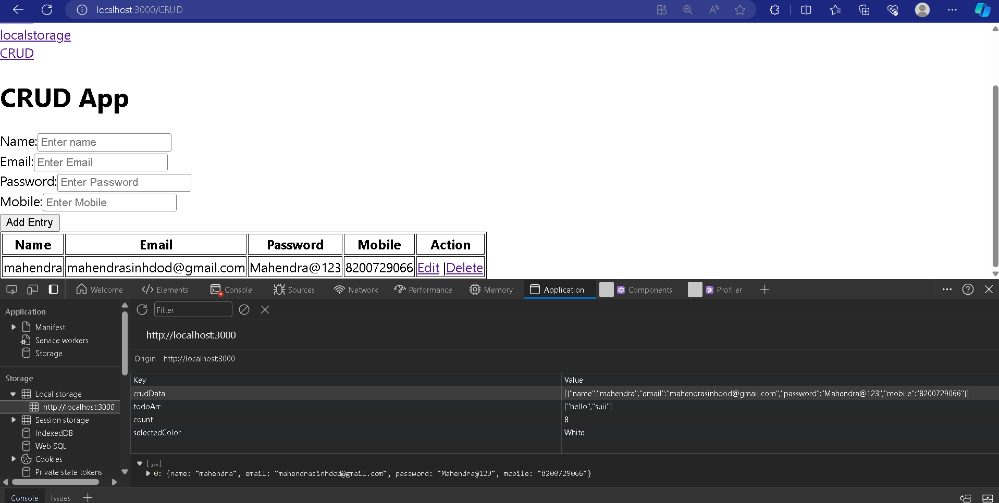
React Tasks

Slide 12
Week-9 To 12
Solve PvEdge Project Study Setup Module vailable in Masters Tab issue of not getting formulation data

Slide 13
Debug PvEdge Project Client Master Module and understand its flow

Slide 14
Week-13 To 16
Live Project PvEdge QC Checklist
Advance User has the rights for Data Entry.
Med. Reviewer will be validating the information entered by Advance. QC User will be validating and checking the Quality of Data.
Lastly Submission User is having the rights of Submitting the Case.
Super User has the Main Administrative Rights for Creation of Masters-Clients, Projects etc. Apart from that user also has the rights of Report Creation, generate Audit details and MedDRA Management.

Slide 15
Week-13 To 16
About Live Project
Case Management: PvEdge provides a centralized platform for case management, enabling users to capture, process, and track adverse events and other safety-related information in a timely and efficient manner.
Signal Detection: PvEdge helps identify potential safety signals by analyzing and aggregating safety data from various sources, including clinical trials, post- marketing surveillance, and spontaneous reports.

Slide 16
Login Page

Slide 17
Home Page

Slide 18
Case Creation

Slide 19
Product Tab

Slide 20
Checklist Yes ADR Page

Slide 21
Checklist No ADR Page

Slide 22
Checklist No ADR Page Tab Drop Down

Slide 23
Checklist No ADR ADD Page

Slide 24
QC Checklist Report Page

Slide 25
QC Checklist Individual Report Page

Slide 26
QC Checklist Individual Report Page

Slide 27
QC Checklist Cumulative Report Page

Slide 28
QC Checklist Cumulative Report

Slide 29
QC Checklist Individual Report

Slide 30
Conclusion
One of the most rewarding aspects of this internship was the chance to collaborate with experienced developers, learning from their expertise and receiving constructive feedback on my work.

Slide 31
References
https://www.w3schools.com/sql/sql_view.asp
https://learn.microsoft.com/en-us/aspnet/core/mvc/overview
https://visualstudio.microsoft.com/vs/
https://www.w3schools.com/react/default.asp
https://react.dev/

Slide 32
Thank You !!

